Slide 1
CSC 101 Applied Physics Spring 2023
Today’s topic:
Moment of a Couple
Chapter-4 Force System Resultants

Slide 2
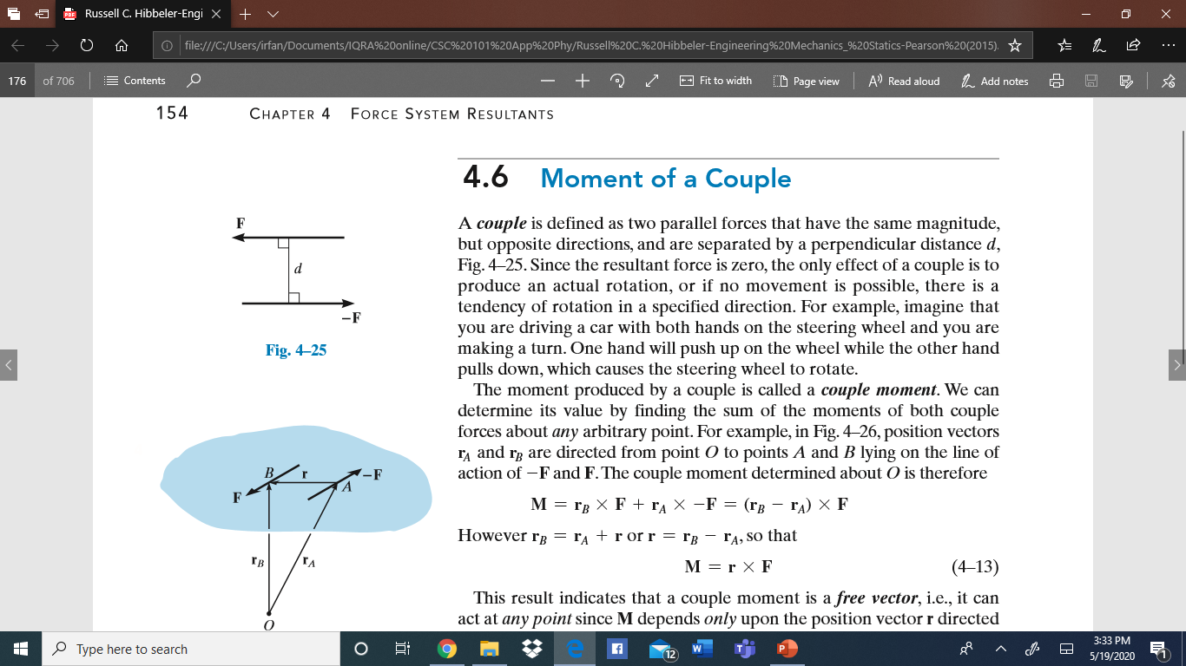
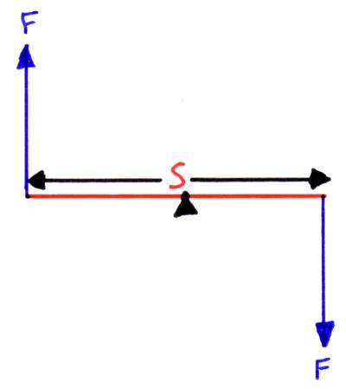
Chapter-4 Force System Resultants
4.6 Moment of a Couple
Couple: Two equal and opposite elements. It is a
special form of Moment
A couple in vectors is defined as two parallel forces that have the same magnitude, but opposite directions, and are separated by a perpendicular distance d, Fig. 4–25 (a)
Two Forces Fs are acting as parallel but they are opposite to each other Fig (b)
Since the resultant force is zero, because forces are equal and opposite, therefore only effect of a couple is to produce an actual rotation
(a)
(b)

Slide 3
Chapter-4 Force System Resultants
4.6 Moment of a Couple
when any movement is possible, there is a tendency of rotation in a specified direction in diagram (a)
In diagram (b), the two forces are parallel, and a rotation is possible
Two forces that are equal in magnitude, opposite in sense and do not share a line of action (It means their point of acting is at different positions/locations)
(a)
(b)

Slide 4
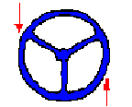
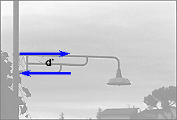
Chapter-4 Force System Resultants
4.6 Moment of a Couple
For example:
imagine that you are driving a car with both hands on the steering wheel and you are making a turn. One hand will push up on the wheel while the other hand pulls down, which causes the steering wheel to rotate
For example:
A common street lamp creates a moment. The two forces of the couple can be seen and tension forces that are separated by a much smaller distance.

Slide 5
Chapter-4 Force System Resultants
4.6 Moment of a Couple
Couple-Moment
The moment produced by a couple is called a couple moment
We can determine its value by finding the sum of the moments of both couple forces about any arbitrary point.
This couple moment will have both Magnitude and Direction

Slide 6
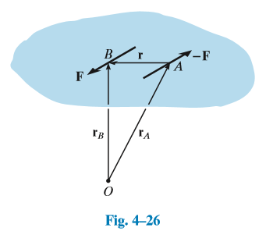
Chapter-4 Force System Resultants
4.6 Moment of a Couple
Couple-Moment
Two forces are acting as shown in fig 4-26; F and -F
The perpendicular distance between these two forces is r
The Force F is acting at a line of action passes through point B
The Force –F is acting at a line of action that passes through point A

Slide 7

Chapter-4 Force System Resultants
4.6 Moment of a Couple
In Fig. 4–26, position vectors r_{A} and r_{B} are directed from point O to points A and B lying on the line of action of -F and F.
The couple moment determined about O would be therefore given by:

Slide 8
Chapter-4 Force System Resultants
4.6 Moment of a Couple
This result indicates that a couple moment is a
free vector, it means that
Moment of a couple M depends only upon the position vector r directed between the forces while
M does not depend on the position vectors r_{A} and r_{B}, directed from the arbitrary point O to the forces.

Slide 9
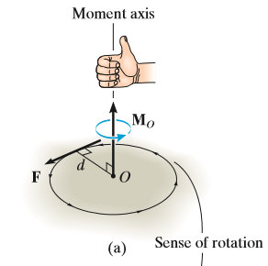
Chapter-4 Force System Resultants
4.6 Moment of a Couple
Scaler Formation of Moment of a couple:
There would be a magnitude of the couple moment
It means that the Magnitude of Moment of
couple can be calculated
As we had calculated magnitude and direction
in our previous lecture about Moment as shown
in fig (a) here at right hand side

Slide 10
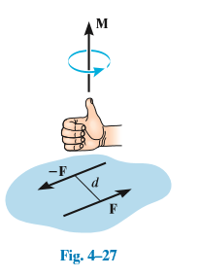
Chapter-4 Force System Resultants
4.6 Moment of a Couple
Scaler Formation of Moment of a couple: Magnitude and Direction
The moment of a couple, M, Fig. 4–27, is defined as having a magnitude of M = Fd
where F is the magnitude of one of the forces and d is the perpendicular distance or moment arm between the forces.
The direction and sense of the couple moment are determined by the right-hand rule.
The thumb indicates this direction when the fingers are curled with the sense of rotation caused by the couple forces.
In all cases, M will act perpendicular to the plane containing these forces

Slide 11
Chapter-4 Force System Resultants
4.6 Moment of a Couple
Vector Formation: Magnitude and Direction by Using Cross Product of F and d
The moment of a couple can also be expressed by the vector cross product using Eq. 4–13, i.e.,
M = r x F equation 4-15
Taking the moments of both forces F and –F about a point lying on the line of action of one of the forces.
For example, if moments are taken about point A in Fig. 4–26,
The moment of -F is zero about this point, and the moment of F is defined from Eq. 4–15 above

Slide 12
Chapter-4 Force System Resultants
4.6 Moment of a Couple
Therefore, in the vector formulation r is crossed with the force F to which it is directed.
That means F is directed towards r, as in fig-4-26

Slide 13
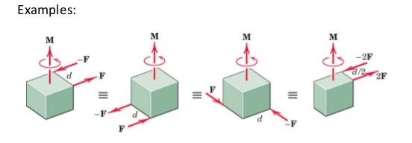
Chapter-4 Force System Resultants
4.6 Moment of a Couple: Examples
The two forces with different magnitudes are applied on different objects as shown in figure here below:
Internet resources

Slide 14
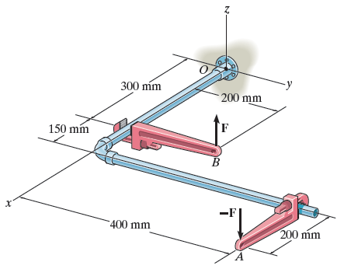
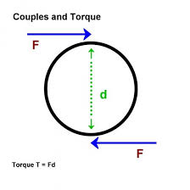
Chapter-4 Force System Resultants
4.6 Moment of a Couple: Examples
The two forces with different magnitudes are applied on different objects as shown in figure here below:
Internet resources

Slide 15
Chapter-5
Equilibrium of a Rigid Body
and
Conditions for Rigid-Body Equilibrium

Slide 16
Chapter-5 Equilibrium of a Rigid Body
5.1 Conditions for Rigid Body Equilibrium
Rigid Body: A rigid body means, an object/body which is tough and difficult to deform/change
It means, that when we apply force on that object, there is hardly any change in the formation (molecules) of that body
We can also say, that there is very small deformation/change in that object
We can further say, that distance between two atoms/or two points do ot change when force is applied; so the object is RIGID (HARD)

Slide 17
Chapter-5 Equilibrium of a Rigid Body
5.1 Conditions for Rigid Body Equilibrium
Rigid Body: A rigid body means, an object/body which is tough and difficult to deform/change
A rigid body is considered as a Continuous-distribution of mass
Actually, in a very hard object, almost no mechanical energy is lost if you tap it
Examples:
A ball-bearing made of hardened steel
A perfect spring
Conditions of Equilibrium of Rigid Body:
We need to define some conditions for the equilibrium of a rigid-body, so that when forces are applied on that body, there is no change/movement

Slide 18
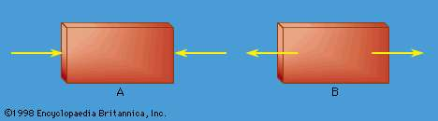
Chapter-5 Equilibrium of a Rigid Body
5.1 Conditions for Rigid Body Equilibrium
A body is formally regarded as rigid if the distance between any set of two points in it is always constant.
Equal and opposite forces acting on a rigid body may act so as to compress the body (Figure A) or to stretch it (Figure B).

Slide 19
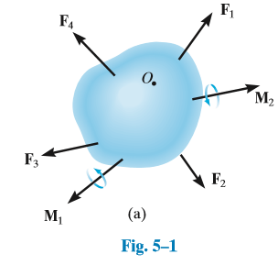
Chapter-5 Equilibrium of a Rigid Body
5.1 Conditions for Rigid Body Equilibrium
Rigid Body:
Shown in Fig 5-1, a rigid body and there are different forces applied on it

Slide 20
Chapter-5 Equilibrium of a Rigid Body
5.1 Conditions for Rigid Body Equilibrium
Rigid Body:
We can also see in the Fig 5-1, some moments M1 and M2 are shown.
These moments are due to the forces, that are applied on the rigid body/object
Moreover, there is also some rotational effects on that object as can be seen by moment M1 and moment M2

Slide 21
Chapter-5 Equilibrium of a Rigid Body
5.1 Conditions for Rigid Body Equilibrium
External Forces and Internal Forces:
External Forces:
As shown in Fig 5-1, some forces are applied on the object, it is clear that these forces are externally applied
It means that these forces are applied on the surface of the rigid body/object; examples of such forces are:
Gravitational force
Magnetic force
Electrical-field (which is also a force E=F/Q)

Slide 22
Chapter-5 Equilibrium of a Rigid Body
5.1 Conditions for Rigid Body Equilibrium
External Forces and Internal Forces:
Internal Forces:
Some forces are applied internally on the object
It means that these forces are applied on the inner surfaces due to the interaction of particles/molecules/atoms, for example
Attractive force due to opposite atoms
Repulsive force due to same atoms
However, these internal forces are not shown in Fig-5-1

Slide 23
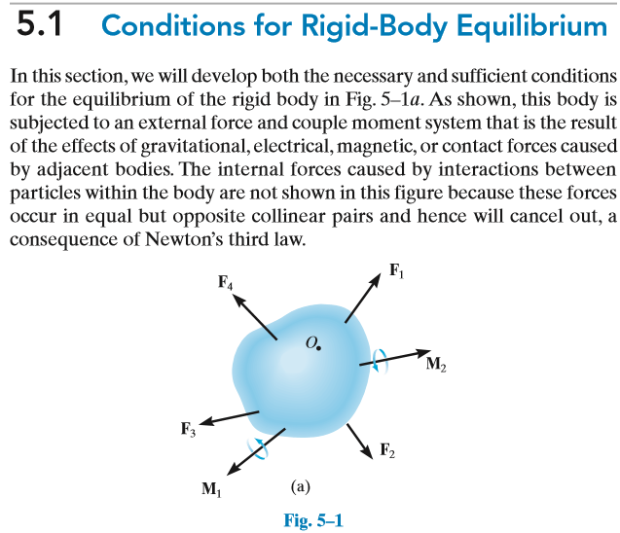
Chapter-5 Equilibrium of a Rigid Body
5.1 Conditions for Rigid Body Equilibrium

Slide 24
Chapter-5 Equilibrium of a Rigid Body
5.1 Conditions for Rigid Body Equilibrium
Conditions for Equilibrium:
Similarly, based on our previous knowledge, we can say that, sum of all the moments that are observed on the object is also zero
Hence, we can say that the object is in equilibrium since::
sum of all the forces that are acting externally is zero
sum of all forces acting internally is also zero
sum of all the moments is also zero

Slide 25
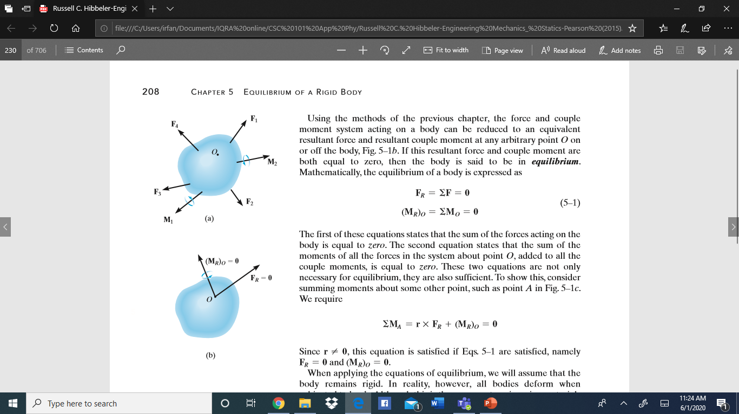
Chapter-5 Equilibrium of a Rigid Body
5.1 Conditions for Rigid Body Equilibrium

